Slide 1
Forest fire Analysis and Prediction
By Anusha Gangasani, Aman Shah, Ashika Anand Babu and Ramya Mahesh Team: Free Thinkers

Slide 2
CONTENTS
Data
Preprocessing
Visualisation
Modeling
Deployment
UI

Slide 3
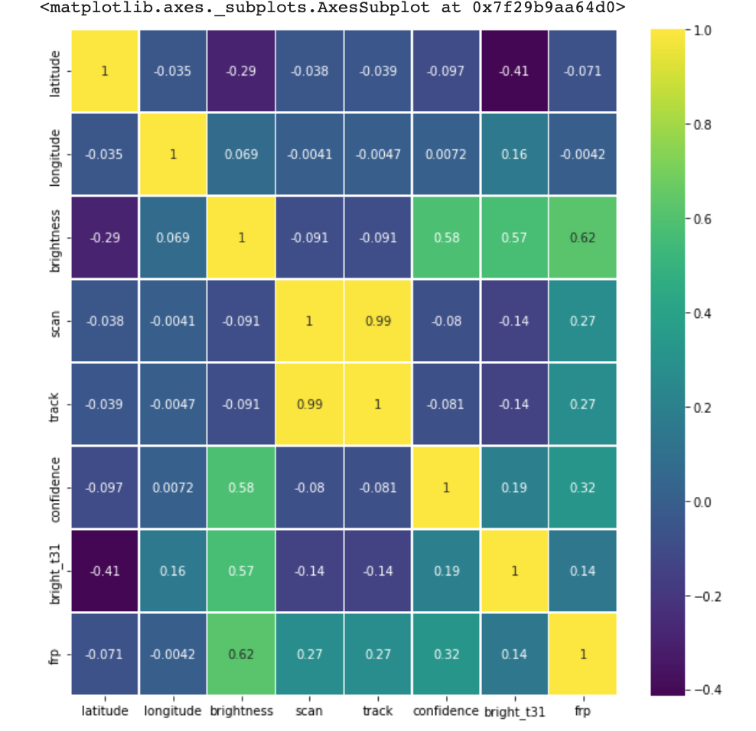
DATA
Obtained global earth data from NASA earth
Half million records for over 2 months from satellites around the world
Heatmap of data before cleaning and preprocessing

Slide 4
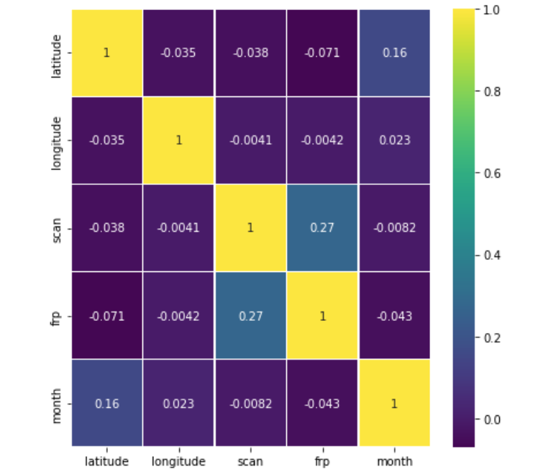
PREPROCESSING
Found over 61 files for entire world
Merged into a single dataset
Identified attributes that are not required
Identified the places i.e., country and state for each latitude and longitude
Heatmap of data after cleaning and preprocessing

Slide 5
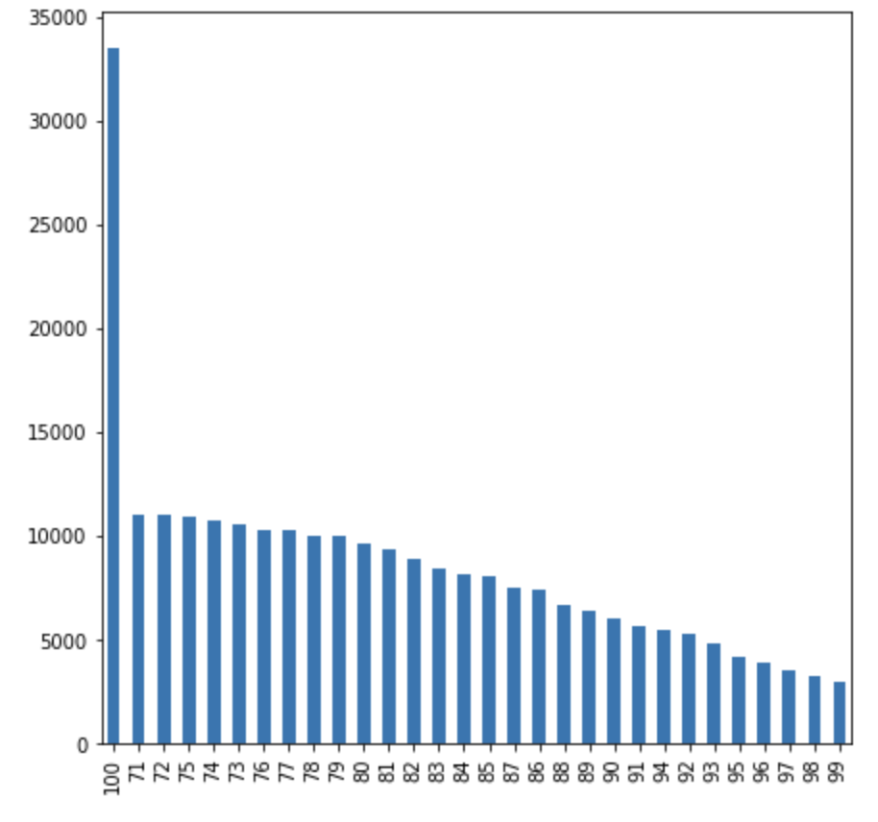
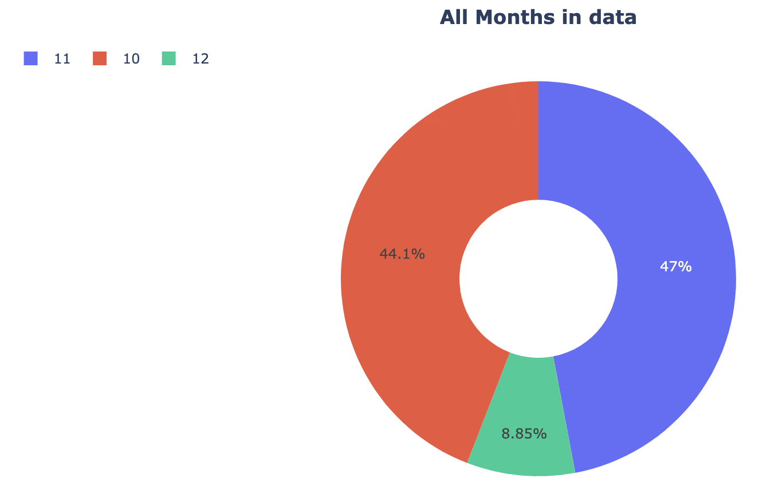
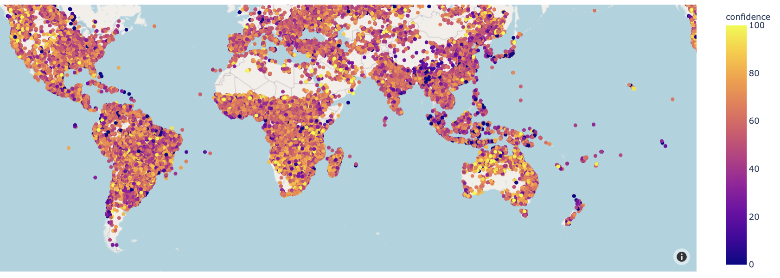
VISUALIZATION
Monthly Data of forest fires
Confidence level > 80
All countries frp level

Slide 6
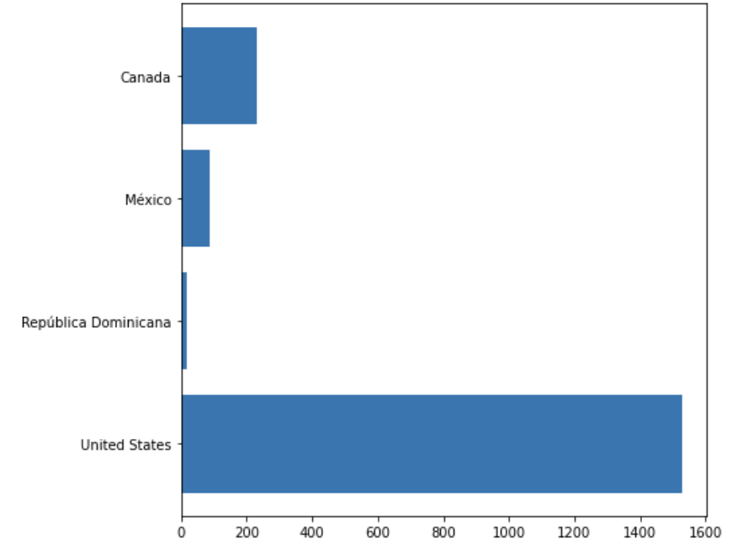
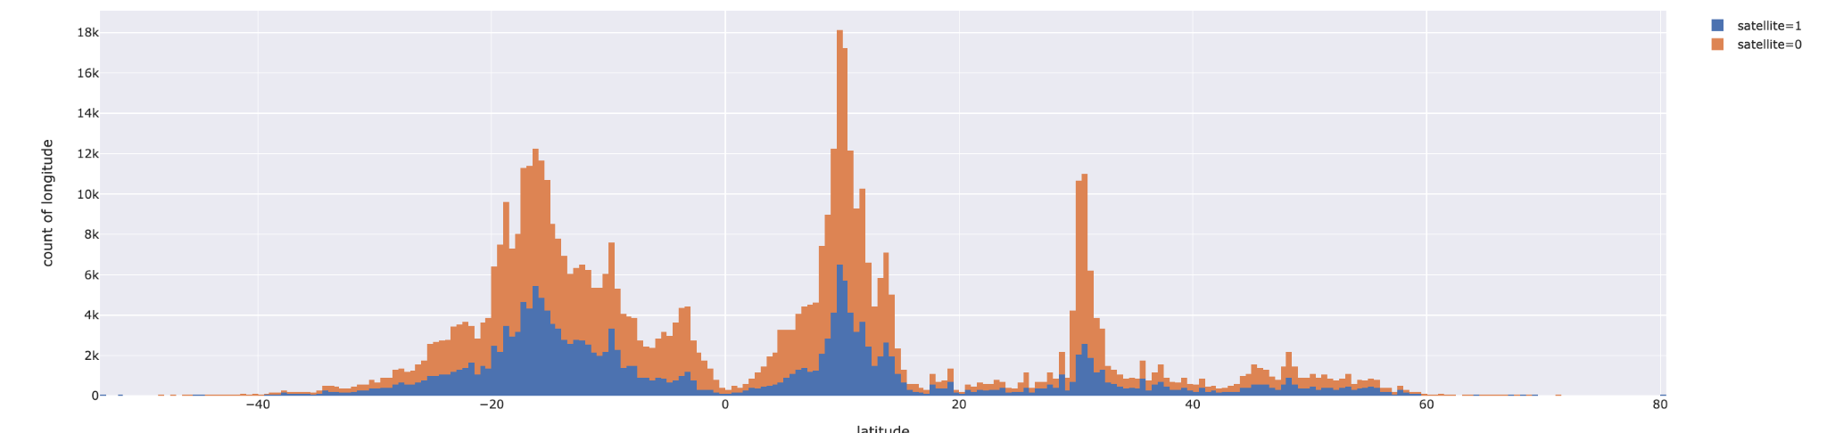
VISUALIZATION
Satellite T and A
Most affected countries in november

Slide 7
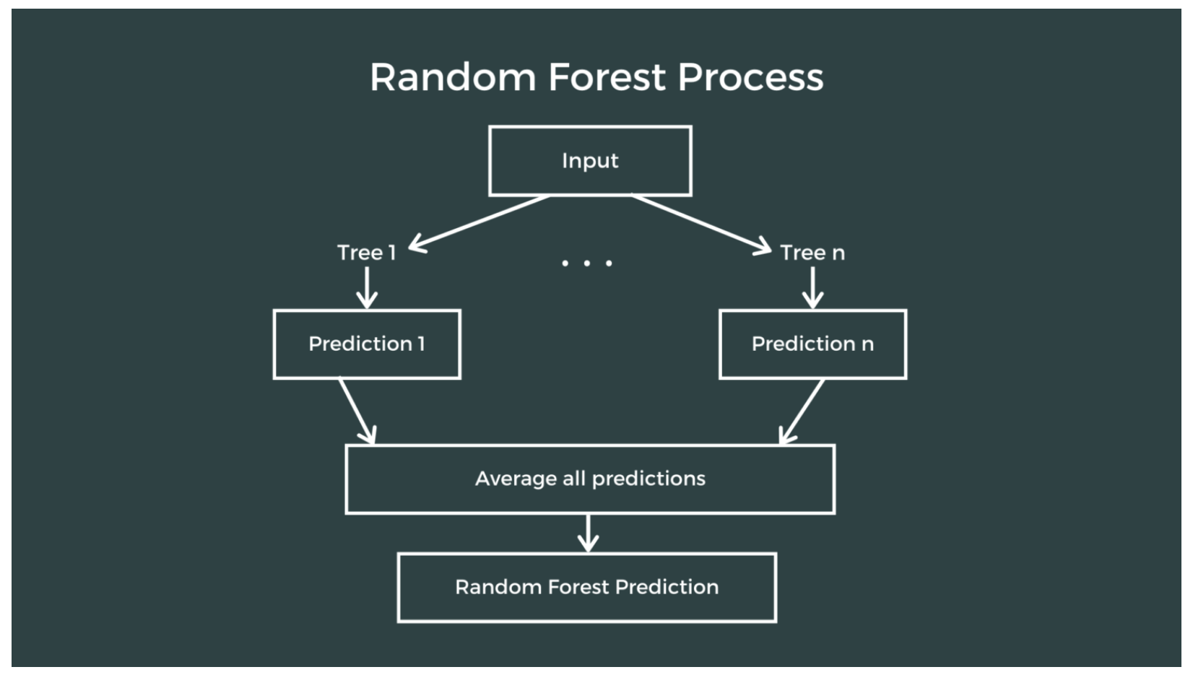
MODELING
Split data into trained and test data sets
Passed through model
Predicted the accuracy of model
Random Forest Regressor model

Slide 8

DEPLOYMENT
Dumped model into pickle file
Loaded the pickle file into AWS EC2 instance

Slide 9
USER INTERFACE
Let’s head straight to the demo.. Now is where everything gets a meaning!! 😊

Slide 10
THANK YOU

